Slide 1
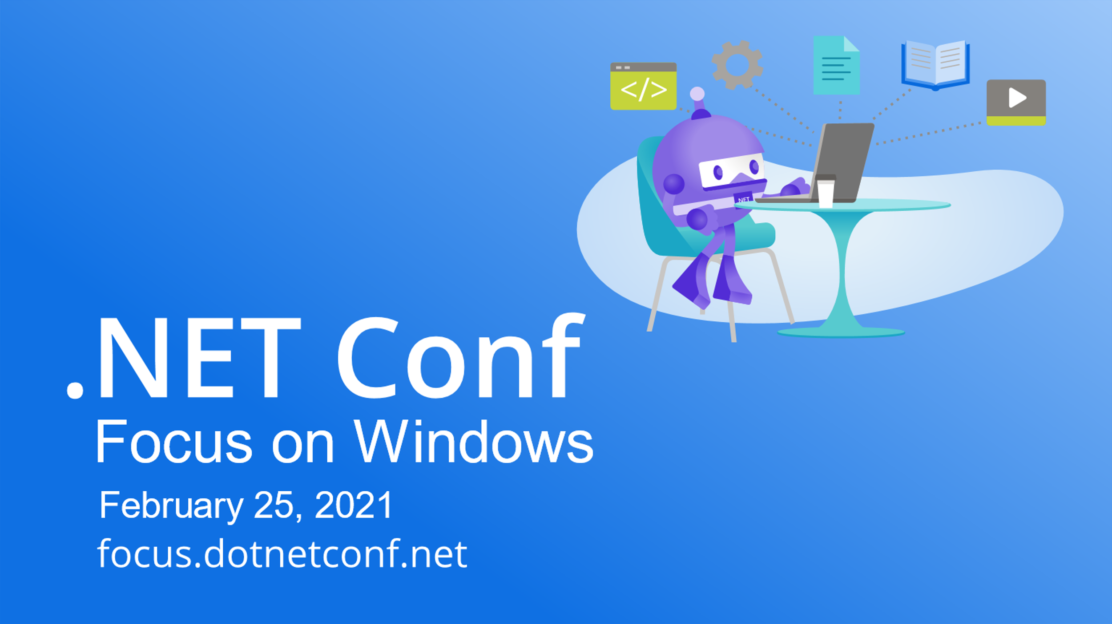

Slide 2


Deploying Windows Apps with ClickOnce on .NET 5
Olia Gavrysh
Jasmine Greenaway

Slide 3

Various ways you can deploy desktop applications
x-copy
MSI
ClickOnce
Windows Store
MSIX
Third-party solutions

Slide 4

ClickOnce Benefits
Easy to publish and install
Automatic updates
No need for administrative permissions
Various options for installation location
Web site
UNC path or file share
USB drive, CD, DVD
Signing manifest
Notes:
Easy to publish and install – the name gives it away
Automatic updates – ClickOnce takes care of updates for your app. You can set up automatic updates and only those parts of the application that have changed will be automatically downloaded, and then the full, updated application will be reinstalled from a new side-by-side folder.
No need for administrative permissions – to install the applications users don’t need admin permissions and ClickOnce grants only those Code Access Security permissions that are necessary for the application.

Slide 5

New in ClickOnce on .NET 5
Self-contained or Framework-dependent deployment modes
Single .exe file
Further improvements

Slide 6


Demo App
WPF app with WinForms dependencies
Targeting .NET 5
Written by Scott Hanselman 13 years ago

Slide 7

Using Azure features
for your desktop deployment process

Slide 8
Azure Blob Storage for Deployments
Publish new app version
Add files to blob container
App accessible via URL
App is installed/updated on machine
Set blob container as the install/update location in application manifest
Can be moved manually or via command line
Users can install via url. Updates applied via app

Slide 9
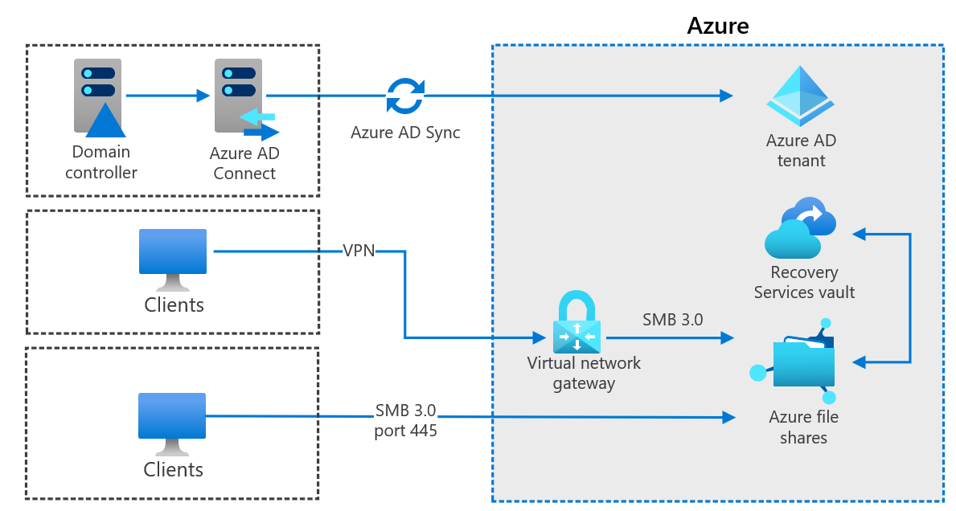
File Storage Hybrid Architecture

Slide 10
Storage Security Options
Access Policies
Shared Access Signature
Azure Active Directory

Slide 11
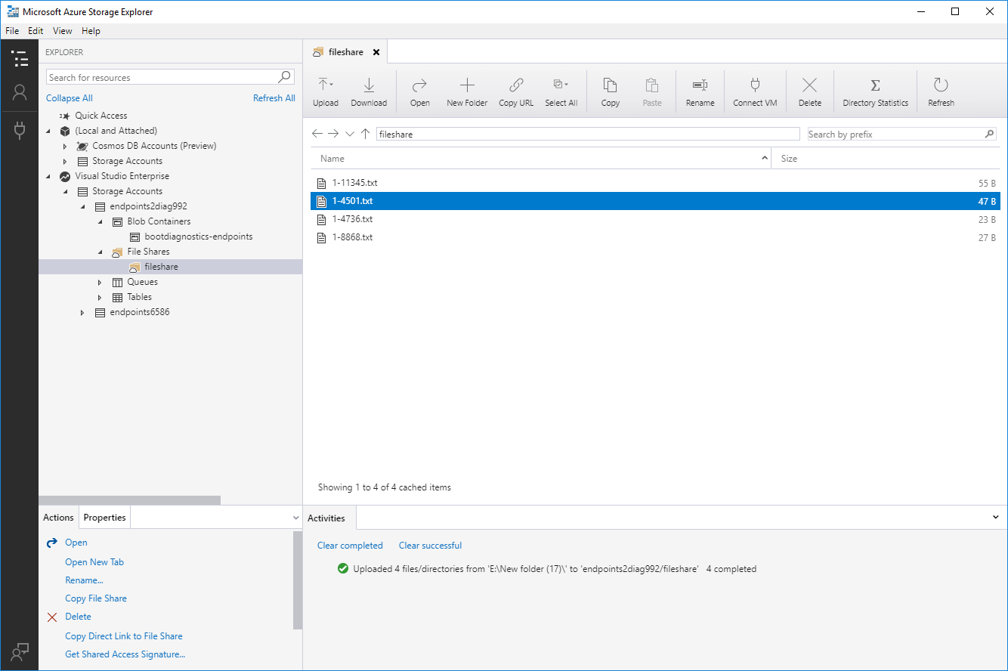
Tooling for Storage
Azure Storage Account
AzCopy Utility
# Basic copy command
.\azcopy copy $source $destination

Slide 12
Moving files to Azure with AzCopy
# Copy published files that have been updated in the past 10 minutes to the blob storage container and overwrite them if they’re newer
.\azcopy copy $publishDirectory $storageContainerURL /
--overwrite=ifSourceNewer /
--include-after (Date).AddMinutes(-10).ToString("yyyy-MM-ddTHH:mm:ss.fffK");

Slide 13

Security with Key Vault
Centralized storage of critical secrets
Certificates
API Keys
Tokens
Passwords
Import existing secrets, or create new ones

Slide 14

Demo
Working with apps and Azure

Slide 15

Thanks for joining!
Ask your questions live on Twitter #dotNETConf
Resources: https://aka.ms/dotnetconf-deploywindowsapps

